Slide 1
Biometric: Vein Authentication Using OPENCV & Deep Learning
Hassan Ashfaq – 2021221
Muhammad Haseeb Ishaq - 2021389

Slide 2
Table of contents
01
02
03
04
05
06
PROBLEM STATEMENT
LITERATURE VIEW & GAP
THE PROPOSED SOLUTION
METHODOLOGY
RESULTS
Conclusion

Slide 3
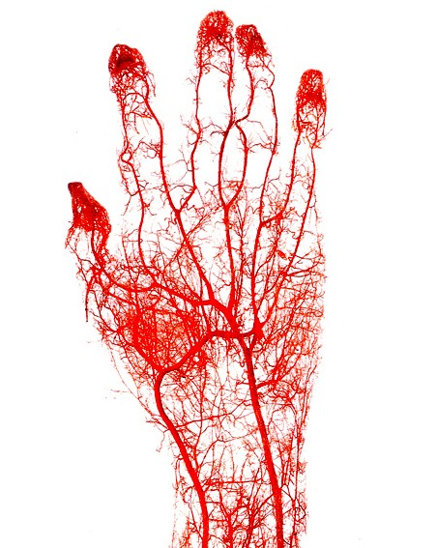
01
PROBLEM STATEMENT

Slide 4
THE PROBLEM STATEMENT
Traditional methods of personal identification often face challenges in accuracy and security. Existing biometric authentication systems, such as fingerprint or iris scanning, may encounter issues like spoofing or inaccuracy. Moreover, these methods can be intrusive and require direct contact, raising hygiene concerns.
We propose leveraging finger vein patterns as a unique biometric identifier for personal identification purposes. Finger vein patterns offer distinctiveness even among identical twins, making them ideal for authentication.

Slide 5
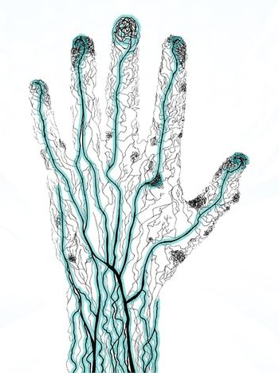
02
LITERATURE REVIEW & GAP ANALYSIS

Slide 6
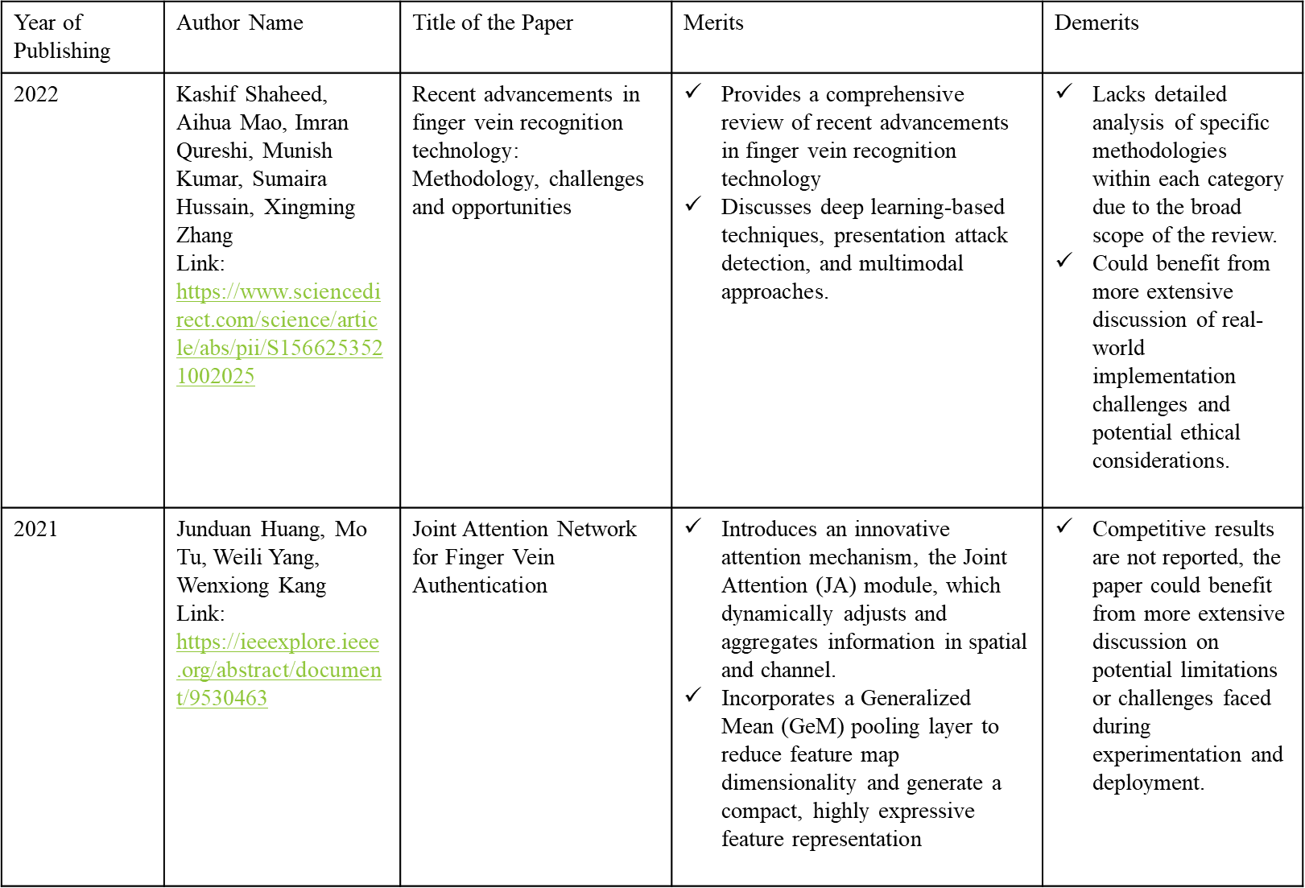
LITERATURE REVIEW STUDY

Slide 7
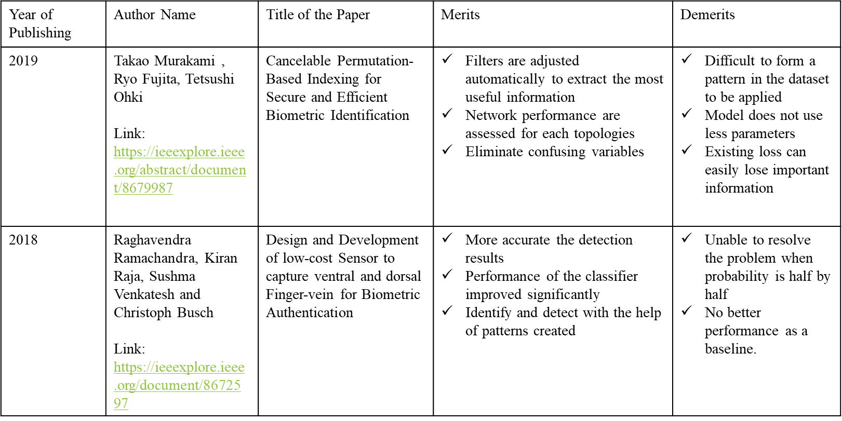
LITERATURE REVIEW STUDY

Slide 8
GAP ANALYSIS
Vein Pattern Complexity and Performance
Local Vascular Structures and Fraud Detection
Neglected Vein Anatomy Analysis
Inadequacies in current vein pattern recognition systems due to flawed vein networks and weak similarities. This suggests a gap in understanding and effectively utilizing the intricate structure of vein patterns for biometric recognition.
A gap in current fraud detection methods, highlighting the significant differences in local vein branches near the bifurcation point of the vein pattern in fake images. This suggests a need for more sophisticated techniques that incorporate local vascular structure analysis to improve fraud detection accuracy.
No emphasis on the importance of a thorough analysis of the vein anatomy structure, which has been largely neglected in existing vein recognition frameworks. This oversight suggests a gap in leveraging anatomical knowledge to enhance the accuracy and reliability of vein pattern recognition.

Slide 9
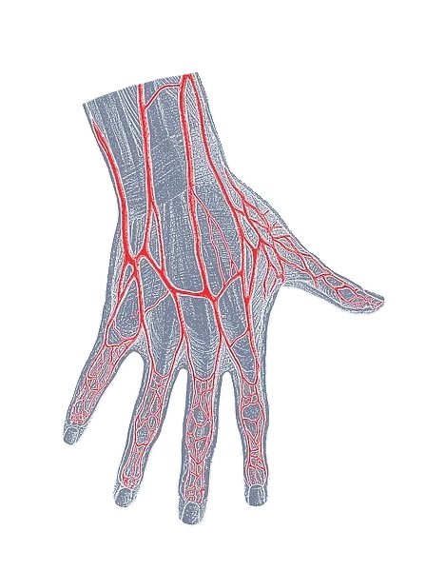
03
THE PROPOSED SOLUTUON

Slide 10
PROPOSED SYSTEM
01
02
03
The large-scale finger vein based biometric solutions demand the need of searching the probe finger vein sample against the large collection of gallery samples.
To improve the reliability in searching for the suitable identity in the large-scale finger vein database, it is essential to introduce the finger vein indexing and retrieval scheme.
It proposes a biometric system to identify people based on the pattern of finger vein. The system uses a database of human index finger images acquired on infrared range.
04
05
06
The present proposal has applied Sobel detector, enhancement filter and a binarization process to get the vein pattern.
The proposed system is implemented using novel finger vein recognition algorithm.
Dimension and Gabor filter are the algorithms used for feature extraction and using the distance classifier the matching of the extracted feature.

Slide 11
04
METHODOLOGY FIGURE

Slide 13
METHODOLOGY STEPS
Exploratory data analysis encompasses both non-graphical and graphical approaches, examining data univariately and multivariate. Matplotlib facilitates visualizing data of any scale.
Data preprocessing involves steps like image sharpening, thresholding, erosion, Sobel filtering, scaling, and contouring. Feature selection automates the process of selecting predictive variables, mitigating overfitting, enhancing accuracy, and reducing training time.
Techniques like activation functions, batch normalization, and image data generators contribute to optimizing deep learning models by enhancing learning.

Slide 14
05
RESULTS & DISCUSSION

Slide 15
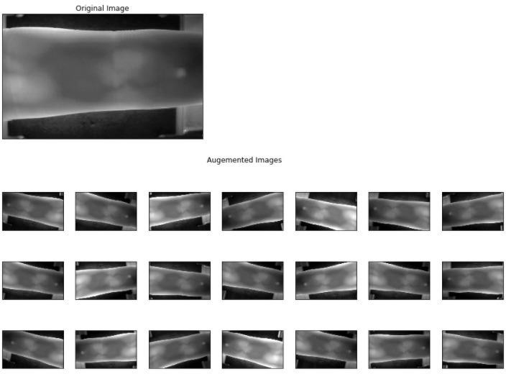
RESULTS AFTER PRE-PROCESSING

Slide 16
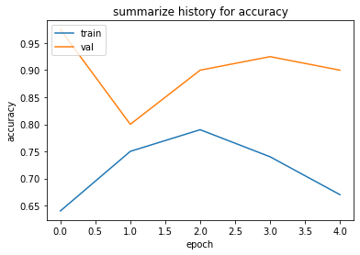
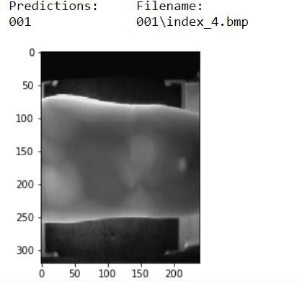
TRAINING & VALIDATION ACCURACY

Slide 17
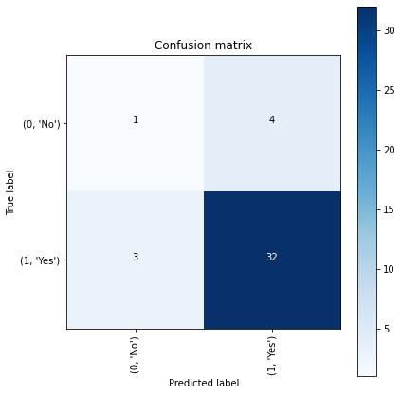
CONFUSION MATRIX VALIDATION

Slide 18
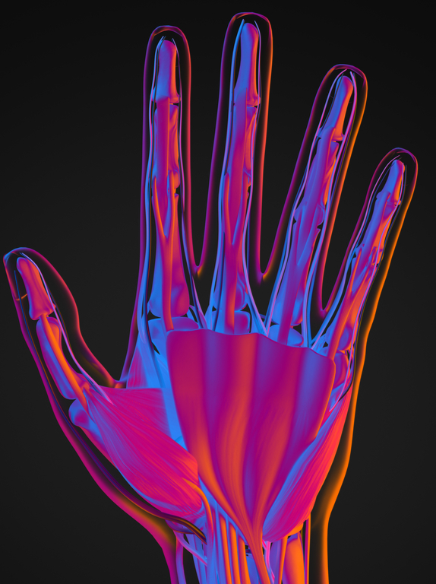
06
CONCLUSION

Slide 19
CONCLUSION
The proposed method is suitable for measurement in the first phase and is used in large batches.
An algorithm has been used in the extraction of the vein pattern, including the curvature method directed at the shape map and the anatomy structure based on the vein network refinement.
Future research - biometric authentication

Slide 20
Thanks
Do you have any questions?

